Slide 1


OPTIMISATION OF ROAD RUNOFF PREDICTION MODELS W.R.T EUROPEAN CONTEXT
HUSSAIN ABBAS (1962156)
SUPERVISED BY PAOLA DIMASCIO

Slide 2
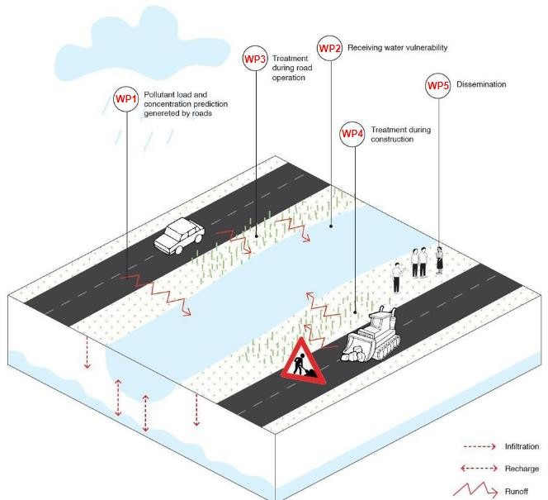
ROAD RUNOFF
PROBLEM
The pollutants generated through the traffic and road construction and maintenance can be automatically deposited in the soil, or emitted into the air. Although the sources of pollutants in these infrastructures are well defined, literature indicates that the prediction of pollutant loads and concentrations is uncertain .
SOLUTION
Do critical analysis of all the predicting tools used so far and based on that develop a new model that’s comparatively more accurate

Slide 3
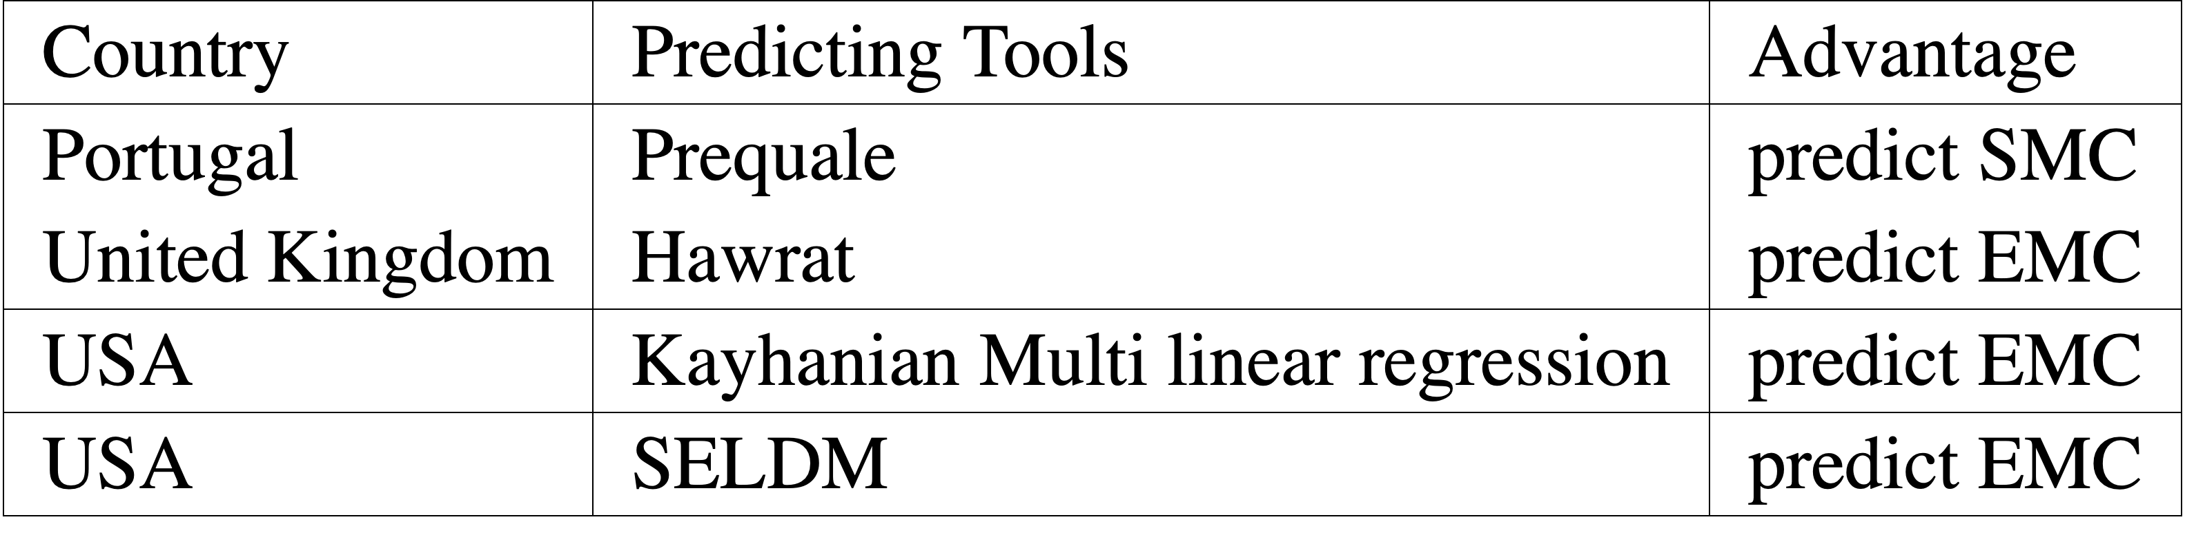
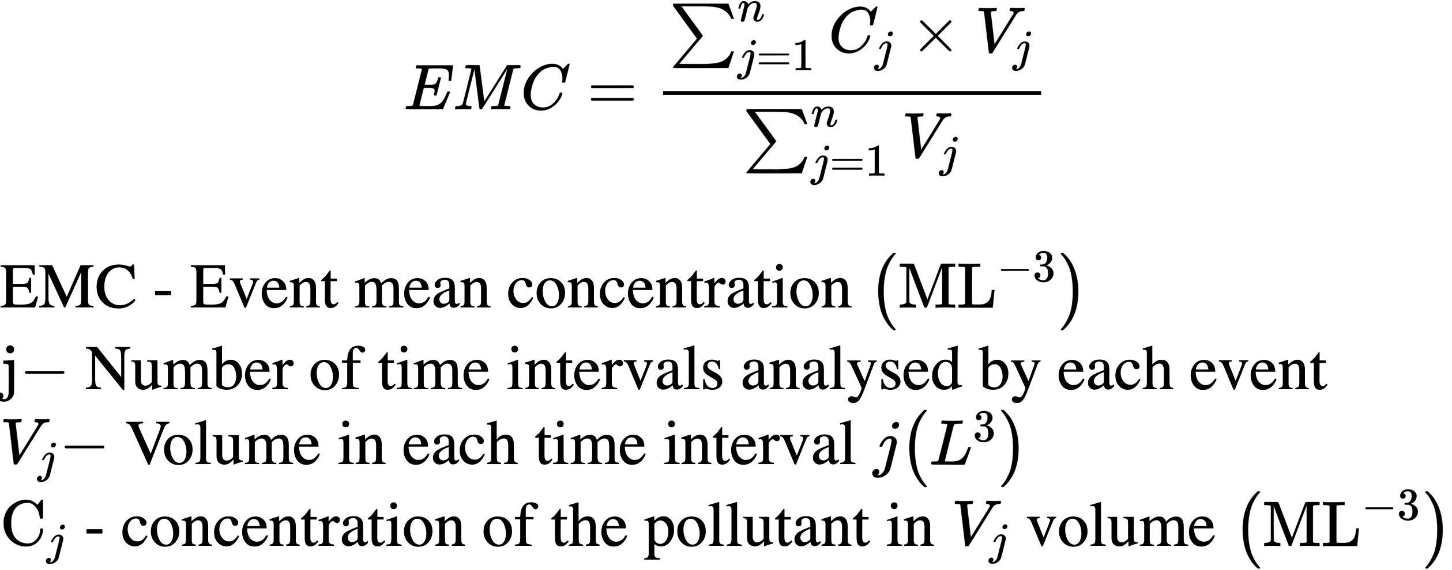
OBJECTIVES
Following are the main objectives:
Characterisation of the road runoff in European context;
Collection and analysis of available monitored data;
The assessment of road runoff predicting tools
PREQUALE
HAWRAT - Highways Agency Water Risk Assessment Tool
Kayhanian’s multiple linear regression method.
SELDM - Stochastic Empirical Loading and Dilution Model
Development of a new SMC prediction model.

Slide 4
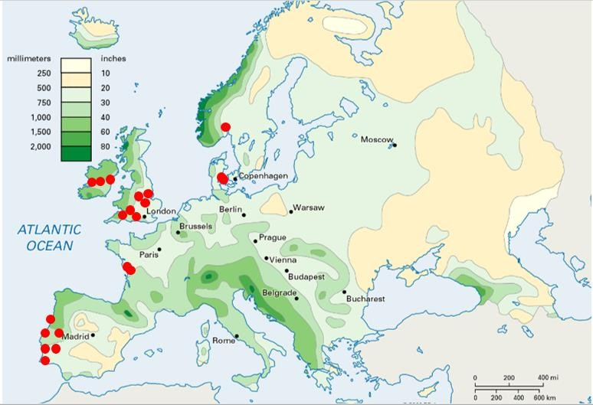
DATA USED

Slide 5
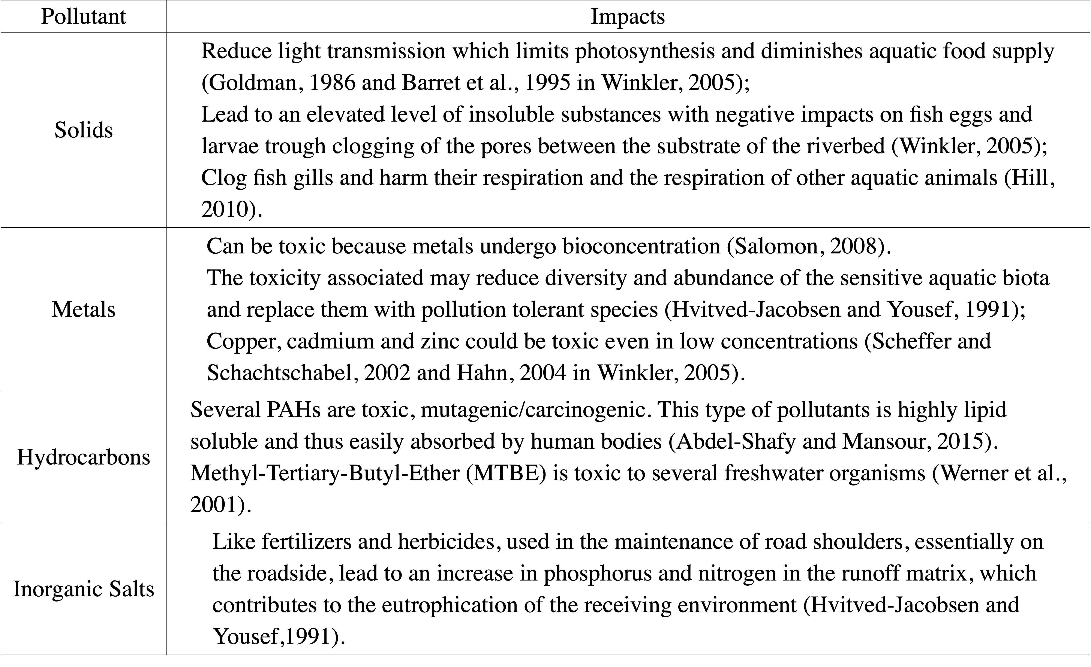
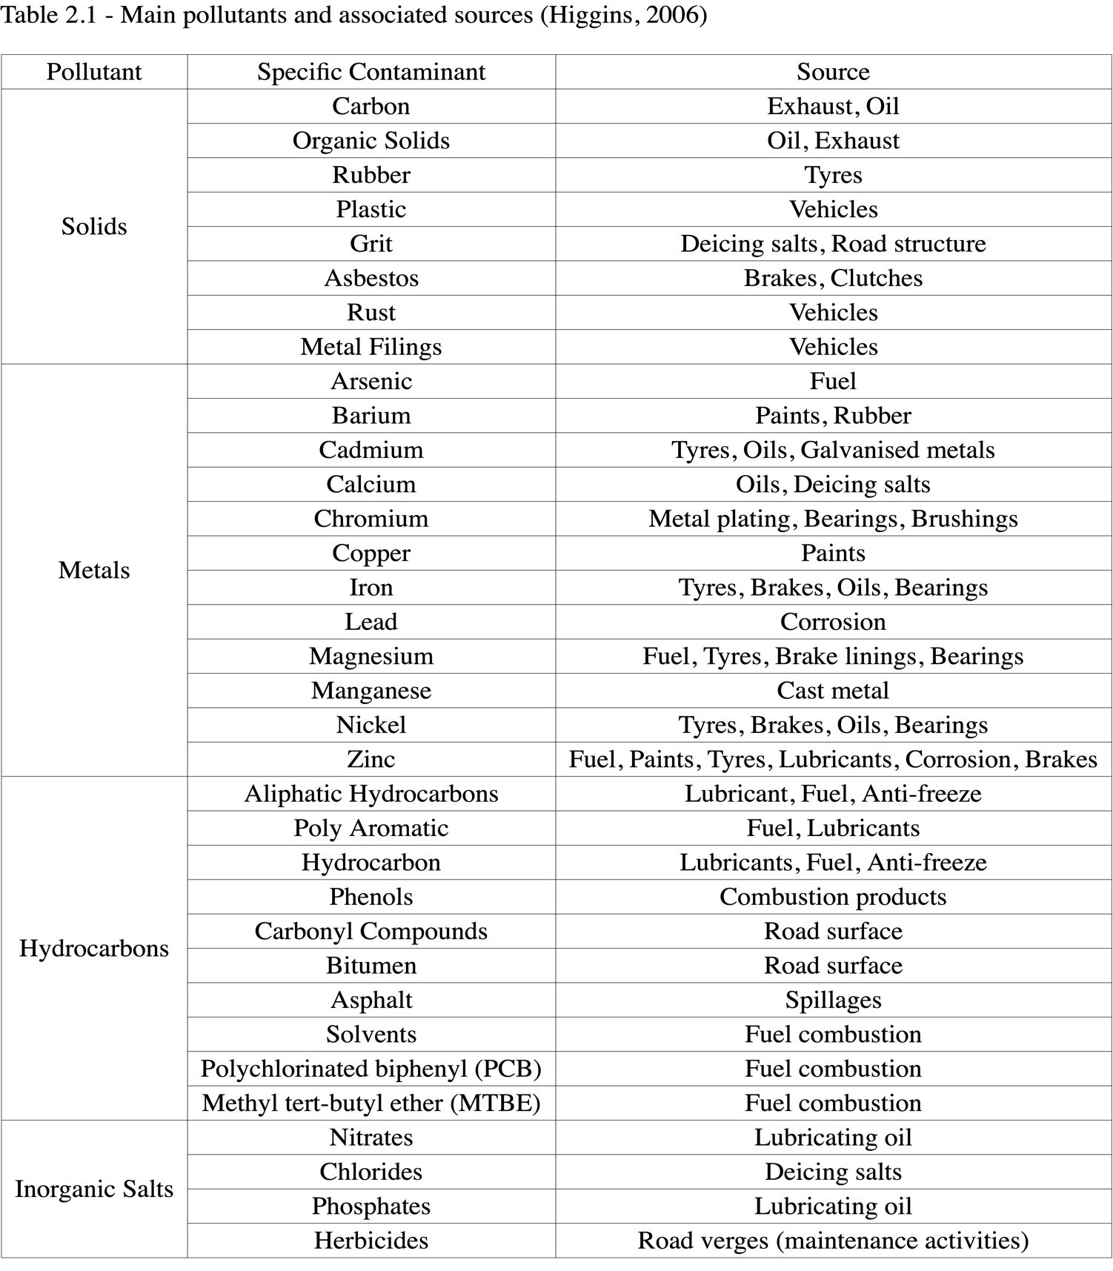
POLLUTANTS STUDIED

Slide 6
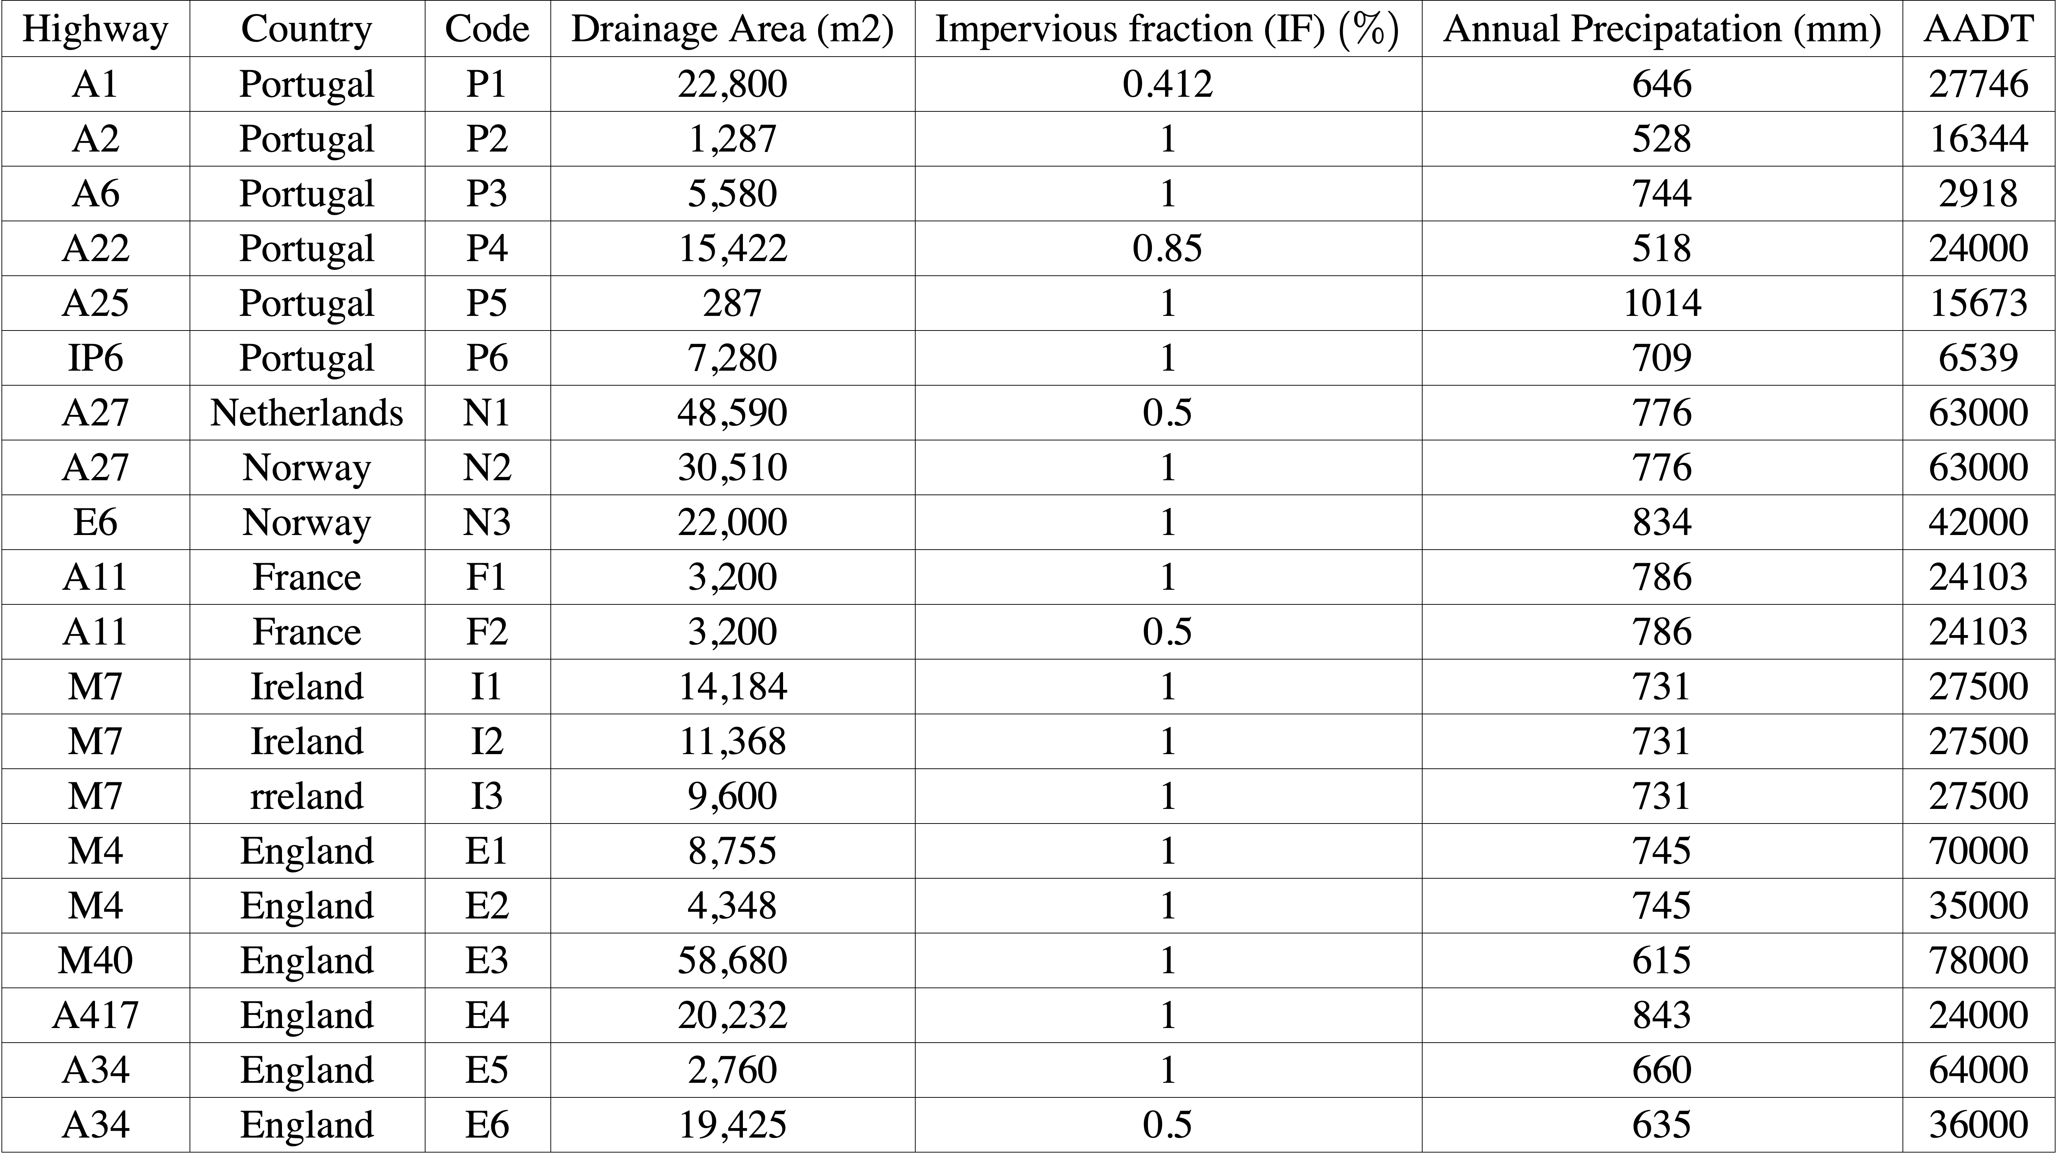
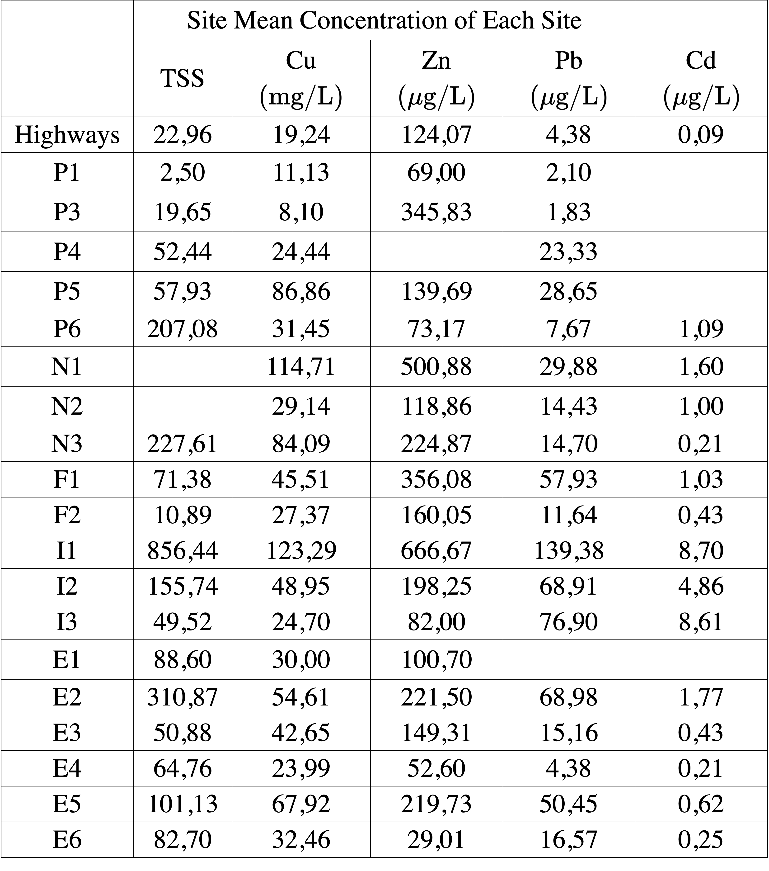
DATA COLLECTION
SITE MEAN CONCENTRATION
INPUT DATA
TEST RESULTS

Slide 7
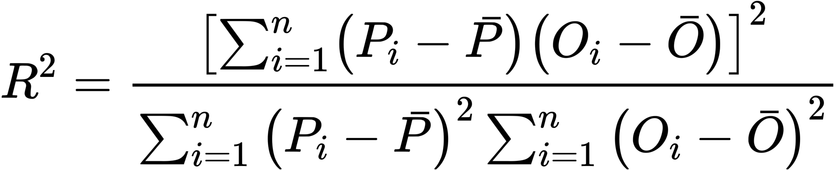
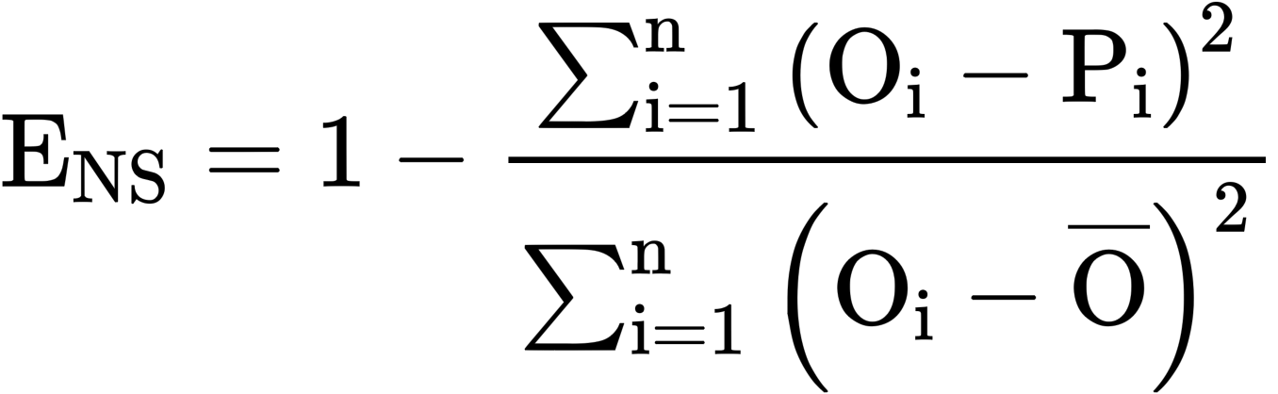
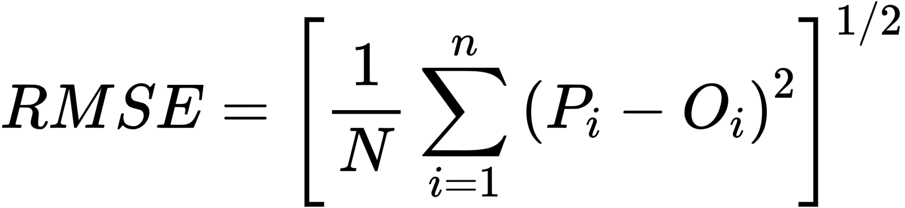
EVALUATION OF PREDICTING TOOLS
All the predicting tools are evaluated using the following three parameters
Coefficient of Determination, R²
It tells the correlation between two variables
Where
Pi= predicted value
Po= mean of predicted value
Oi= observed value
Oo= mean of observed value
If
R2=0 / No Correlation
R2=1 / Strong Correlation
ENS Coefficient
It tells the predictive power of model
Where
Pi= predicted value
Oi= observed value
N= no of samples
If
ENS>0.75 / Good Model to predict road runoff
ENS=1 / Perfect Model
Root Mean Square Error, RMSE
Difference b/w predicted and observed value. Its always non-negative
Where
Pi= predicted value
Oi= observed value
N= no of samples
If
RMSE=0 / Perfect Fit Data

Slide 8
PREQUALE PREDICTING TOOL
Project Between 2002 and 2006, road runoff from multiple roads was monitored
G-Terra research project, sponsored by the Portuguese Foundation for Science and Technology
PREQUALE tool was built using data from six routes.
This method seeks to directly predict SMC.
It i s based on the following principles:
input data easily available for designers;
easiness of calculation (multi linear regression eq);
clear and transparent model and
reliable results at national level.
SMC = a_{i} (DA^{β1} × IF^{β2} × AR^{β3} × P_{annual}^{β4} )
ai, β1, β2, β3, β4
DA (Drainage Area)
IF (Impervious Area)
AR (Annual Rainfall)
Regression coefficients
Area used to discharge Runoff
Percentage of area thats concrete
Average rainfall of region. To calculate this we need

Slide 9
KAYHANIAN PREDICTING TOOL
Multiple linear regression (MLR) to predict EMC.
34 Highway runoff quality in California, United States of America (USA);
ln (EMC) = β₀+a ×ln(TER)+b ×ln(ADP)+c ×√CSR³+d ×ln(DA)+e×(AADT ×10⁶)
β0, a, b, c, d, e are Kayhanian coefficients
Total event rainfall (TER in mm) – height of rain of each precipitation event;
Antecedent dry period (ADP in days) – the number of days with no rain since the last precipitation event;
Cumulative seasonal rainfall (CSR in mm) – the total rain of a known season in a specific location.
Drainage area (DA in ha) – area which contributes with runoff to the discharge point during a rainfall event;
Annual average daily traffic (AADT in vehicles/day) – number of vehicles that pass each day in the location

Slide 10
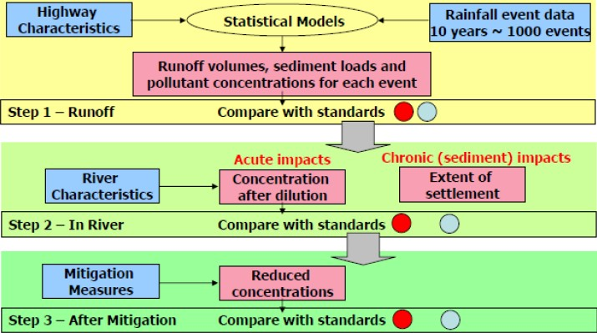
HAWRAT PREDICTING TOOL
Developed by Highways Agency from the United Kingdom as a standalone application aiming at helping highway designers decide if road runoff pollution mitigation measures are needed.
Besides the prediction of runoff, HAWRAT also predict the impact of the runoff on receiving rivers.
HAWRAT comprises three steps:
Step 1 concerns road runoff pollution prediction,
Step 2 is related to the impacts in the receiving water bodies and
Step 3 deals with the selection of mitigation measures.
log10 EMC = PC + CRC + AADTC + MC + γ1 × MHI + γ2 × ADP
Pollutant constant (PC) - Fixed to each pollutant;
Climate region constant (CRC) – Also fixed to each pollutant;
Annual average daily traffic constant (AADTC) – Dependent of the number of cars per day;
Month constant (MC) – Fixed and based on the month that the precipitation event occurs;
Maximum hourly precipitation (MHI in mm/h) – The highest value of hourly precipitation registered in a event;
Antecedent dry period (ADP in hours) – Number of hours without precipitation since the last precipitation event.

Slide 11
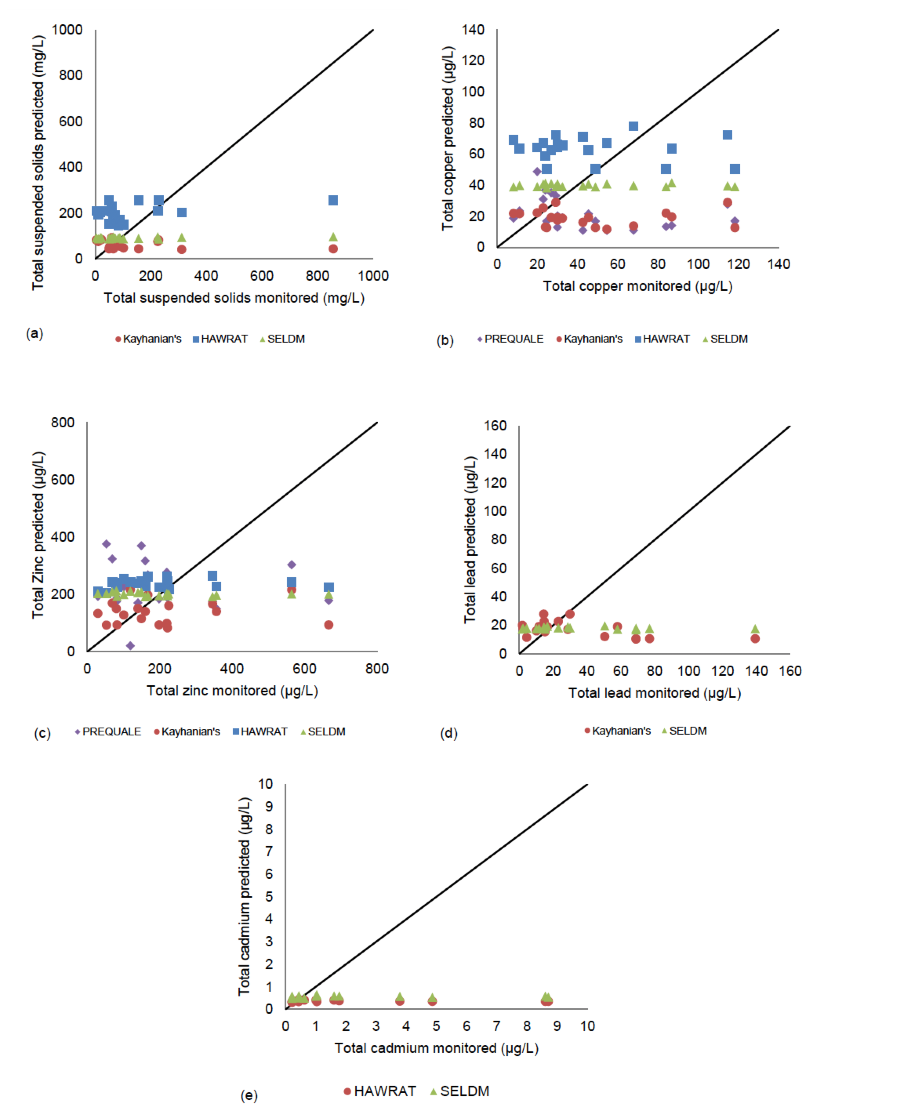
PREDICTED VS OBSERVATION TEST RESULTS

Slide 12
RESULTS
The highest R2 was of 0,28 which is a very low value to guarantee a robust model.

Slide 13
ENS RESULTS
Since all values were below 0,75, it can be concluded that the model is not robust, as previously suggested by the coefficient of determination analysis.

Slide 14
CRITICAL ANALYSIS OF ALL MODELS
 | PROS | CONS
PREQUALE | Simple regression equation Easy to calculate ADP is not used in PREQUALE. It seems to be an advantage since no correlation between road runoff concentration and ADP was noticed in Portuguese and international studies. Use IDF curves for Volume (mm/hr) which are difficult to obtain in UK | The number of roads used to construct the model (six), does not represent a robust quantity and diversity of road characteristics that may be characteristic from all Europe; The model was created from a regression analysis that is only based on four variables. Average annual rainfall volume with the same duration The basin time of concentration (AR), was very hard to find in the monitored data from Europe.
HAWRAT | Easy to calculate; Input data easily available for users; Calibrated with a robust number of monitored roads for UK, which results in good predicting results | Characteristics variability to apply to all Europe is very low; Climate region data of each road is required which is hard to get HAWRAT does not appear to have sensitivity to great variations of SMC, being very constant from site to site.
KAYHANIAN | Easy to calculate; Input data easily available for users. | One input that’s very difficult to obtain in Europe CSR is not widely used in Europe Model made entirely for USA roads, hard to adopt to European studies This method does not appear to have a direct relation between monitored data and predicted data for the highest values of the monitored data.

Slide 15
DEVELOPMENT OF NEW MODEL
Considering the poor performance of the predicting models, the development of a new model is proposed.
The proposed model uses a multiparametric equation that allows the user to predict SMC for TSS (mg/L), copper (μg/L), zinc (μg/L), lead (μg/L) and cadmium (μg/L).
This model is based on the following principles:
(i) input data easily available for the user;
(ii) easiness of calculation
(iii) more robust results for Europe
SMC = β₀ + (a× DA) + b× DL+ (c× IF)+ (d × P_{annual}) + (e× AADT)
The following variables were considered to the model:
Drainage area (DA in m²) – Area that contributes to the runoff;
Drainage length (DL in m) – Length of the road;
Impervious fraction (IF in 0-1) – The fraction of the DA that is concrete;
Annual precipitation (Pannual in mm) – The average of annual precipitations of each site;
Annual average daily traffic (AADT in no of vehicles) – The number of vehicles that pass daily in the site.

Slide 16
OPTIMISATION OF NEW MODEL
- Similar study done in Korea on the Kesoung River
- Three different forms was tested
- To reduce skewness, log is used in Form 2 and 3
FORM 1: the original variables are used to build the MLR model.
SMC = β₀+(a ×DA)+(b ×DL)+(c ×IF)+(d ×Pannual)+(e×AADT )
FORM 2: dependent variables,such as pollutant load, EMC and load/area, are log e-transformed to reduce skewness
ln (SMC) = β₀+(a ×DA)+(b ×DL)+(c ×IF)+(d ×Pannual)+(e×AADT )
FORM 3: all the explanatory and dependent variables are log e-transformed
ln(SMC) = β₀+(a ×ln(DA))+(b ×ln(DL))+(c ×ln(IF))+(d×ln(Pannual))+(e×ln(AADT) )

Slide 17
BEST MODEL 3
ln (SMC) = β₀+(a ×DA)+(b ×DL)+(c ×IF)+(d ×Pannual)+(e×AADT )
where
(i) Drainage area (DA in m²) – Area that contributes to the runoff;
(ii) Drainage length (DL in m) – Length of the road;
(iii) Impervious fraction (IF in 0-1) – The fraction of the DA that is concrete;
(iv) Annual precipitation (Pannual in mm) – The average of annual precipitations of each site;
(v) Annual average daily traffic (AADT in no of vehicles) – The number of vehicles that pass daily in the site.
INPUT / OUTPUT

Slide 18
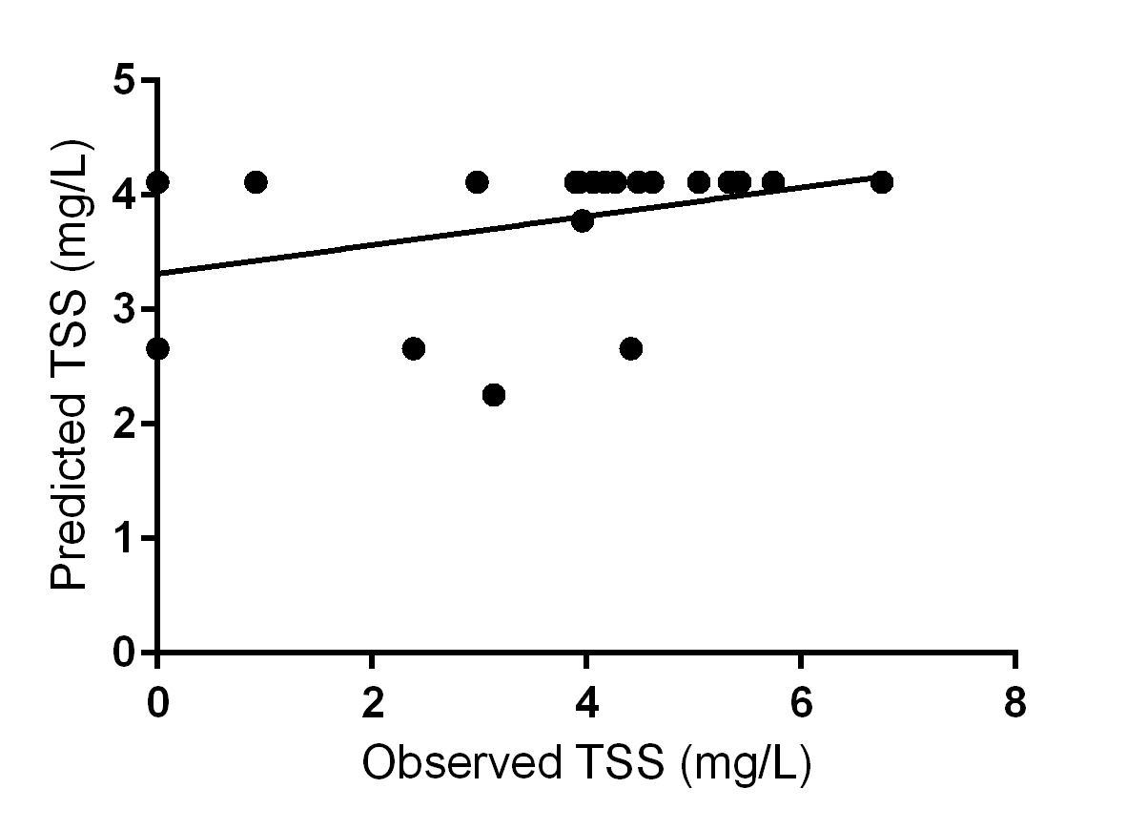
TOTAL SOLUBLE SOLIDS RESULTS

Slide 19
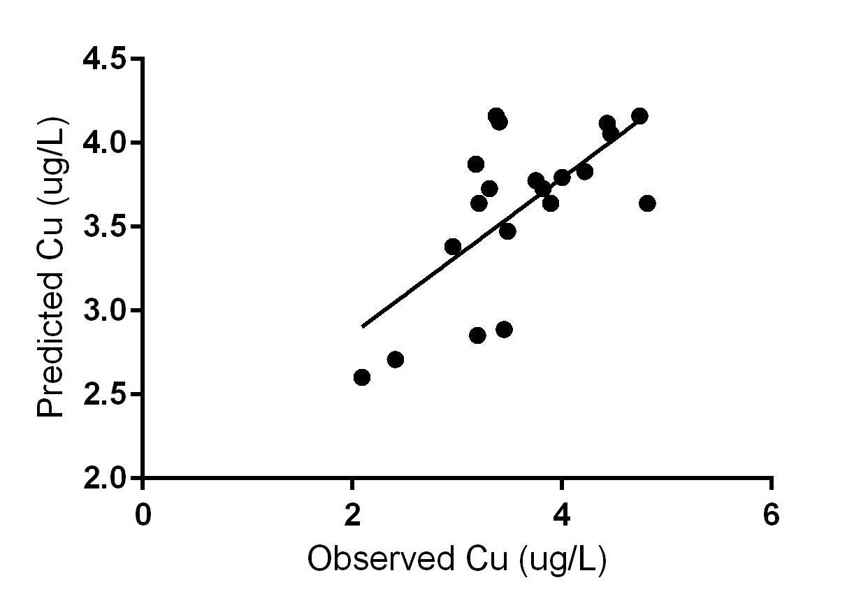
COPPER RESULTS

Slide 20
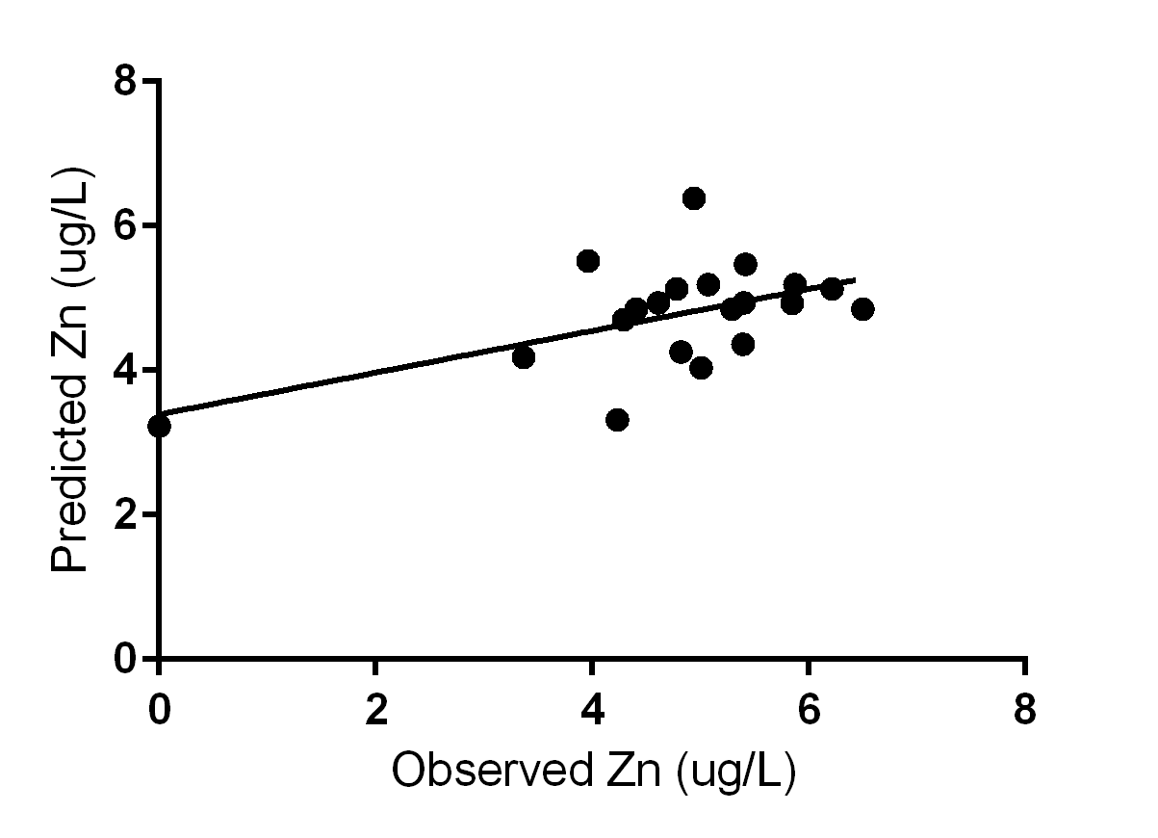
ZINC RESULTS

Slide 21
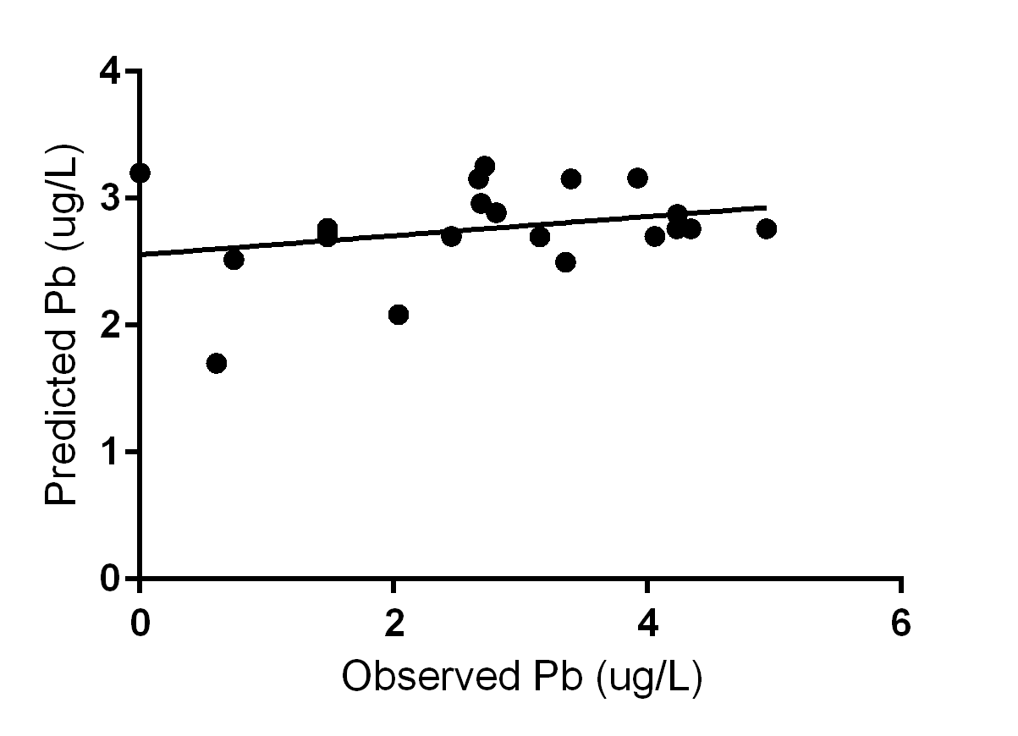
LEAD, Pb RESULTS

Slide 22
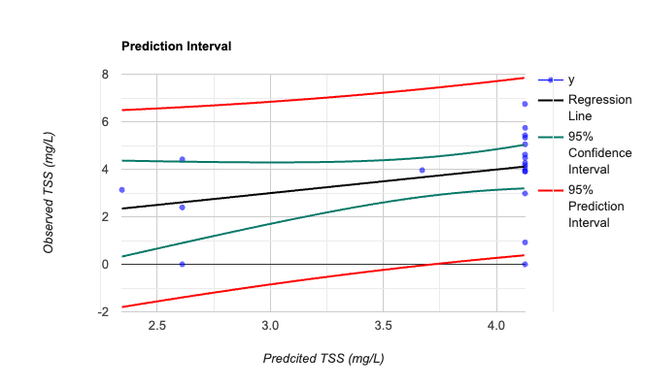
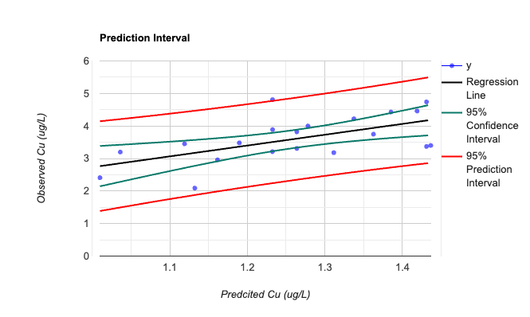
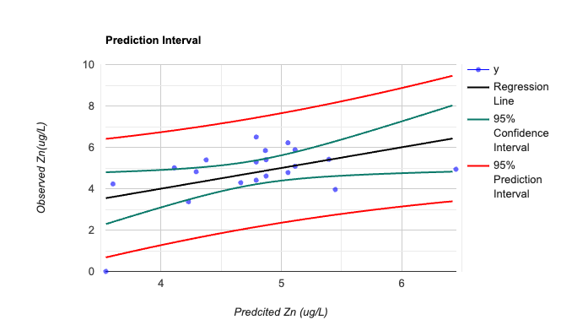
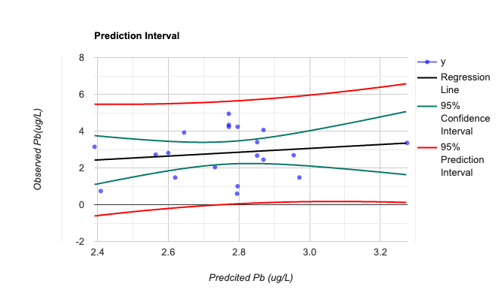
Model 2 Results – Predcition / Confidence Interval

Slide 23
EVALUATION TERMS COMPARISON
 |  | R2 | ENS | RMSE
TSS | NEW MODEL | 0.13 | 0.128 | 164
 | HAWRAT | 0.17 | -0.008 | 193
 | Kayhanian | 0.15 | -0.216 | 212
 | SELDM | 0.18 | -0.041 | 196
COPPER | NEW MODEL | 0.682 | 0.548 | 21
 | PREQUALE | 0.122 | -0.916 | 44
 | HAWRAT | 0.209 | -0.435 | 38
 | Kayhanian | 0.002 | -0.792 | 42
 | SELDM | 0.000 | -0.042 | 32
ZINC | NEW MODEL | 0.511 | 0.44 | 112
 | PREQUALE | 0.009 | -0.377 | 194
 | HAWRAT | 0.011 | -0.021 | 167
 | Kayhanian | 0.007 | -0.192 | 180
 | SELDM | 0.069 | -0.023 | 167
LEAD | NEW MODEL | 0.075 | 0.021 | 33
 | Kayhanian | 0.29 | -0.461 | 42
 | SELDM | 0.06 | -0.254 | 39
Regarding the R² it was noticed that none of the values were close to 1. However, in comparison to the models studied previously, this model presents much higher R², except for lead and TSS.
None of the parameters achieved the perfect value of ENS (ENS=1), however two of the indices indicate a reasonably good performance (copper and zinc).
Concerning RMSE, all indices calculated are much larger than zero. Still, in this case, the error is considered big since the average of the observed data is very close to the error index, which indicates that the error is very large.

Slide 24
FUTURE WORK
Regarding the data of the predicting models, the conclusion is that in the highways runoff the climatic characteristics and land use have more impact than some of the variables usually studied in the models.
Continue the PREQUALE process, for Portugal and Europe.
PREQUALE was developed based on a principle components analysis, and predicts SMC.
Some authors defend that the2 road runoff concentration out of the urban areas does not vary much with the ADP. In this way, PREQUALE with more monitored data could achieve a determination coefficient for each pollutant, much better than the one presented in this work.
After the improvement of these tools or after obtaining the largest number of monitored data possible, it would be possible to define which is the best model to be applied in Europe and start to develop some complementary studies that may allow the European environmental and traffic agencies perform robust environmental evaluation.
Regarding the R² it was noticed that none of the values were close to 1. However, in comparison to the models studied previously, this model presents much higher R², except for lead and TSS.
None of the parameters achieved the perfect value of ENS (ENS=1), however two of the indices indicate a reasonably good performance (copper and zinc).
Concerning RMSE, all indices calculated are much larger than zero. Still, in this case, the error is considered big since the average of the observed data is very close to the error index, which indicates that the error is very large.

